Slide 1
Newton-Rhapson method

Slide 2


Slide 3
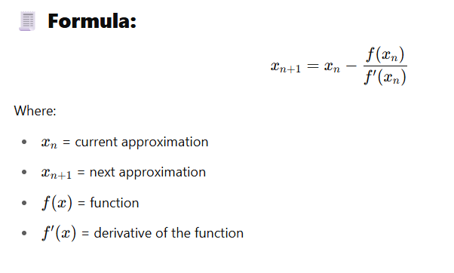

Slide 4
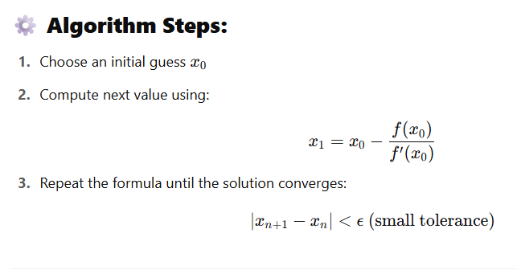

Slide 5
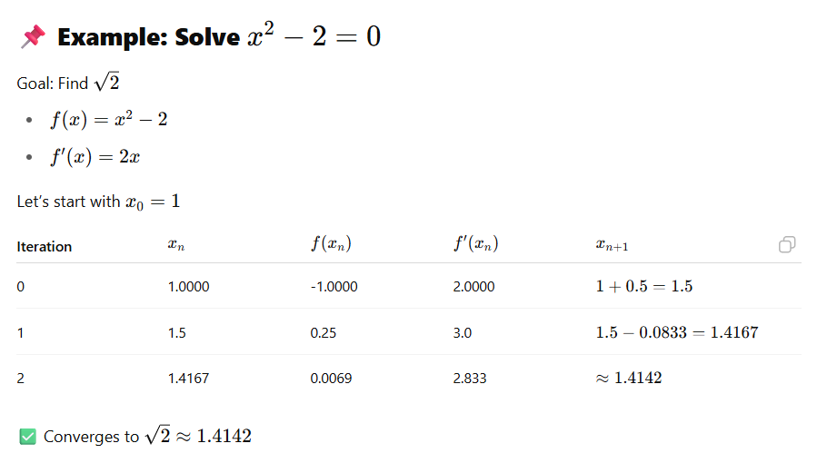

Slide 6
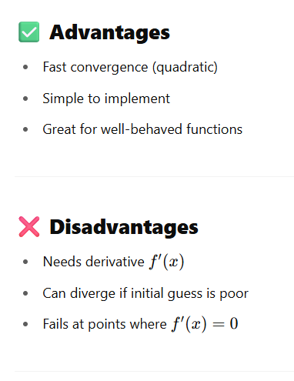
The Newton-Raphson method is known for its fast (quadratic) convergence, which means it gets very close to the true solution very quickly, especially near the root.

Slide 7


Slide 8


Slide 9
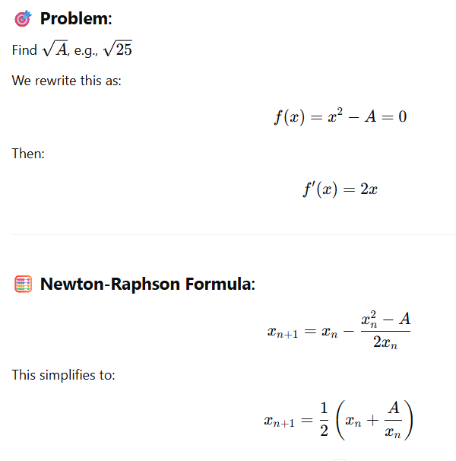
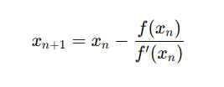

Slide 10
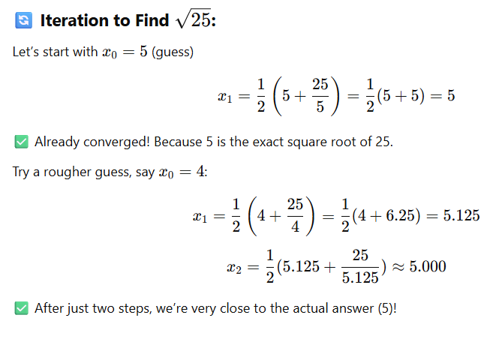

Slide 11


